Slide 1
Gen AI Foundations & Ethics

Slide 2
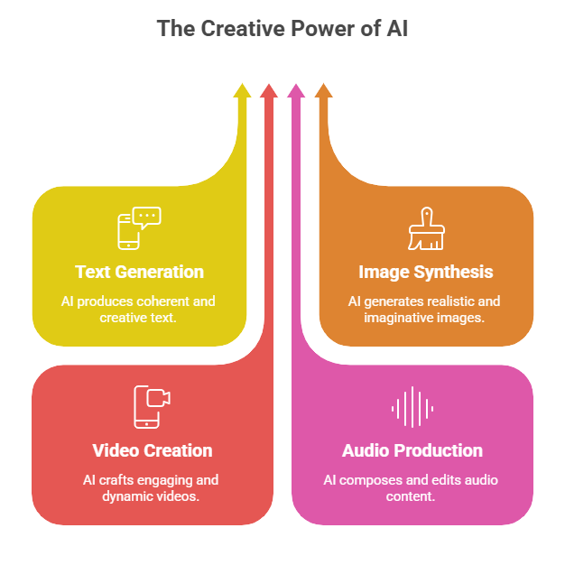
Introduction to Generative AI Landscape
Generative AI creates new content: text, images, videos, and audio.
Uses large models trained on lots of data.
Examples: GPT series, DALL-E, Google Gemini.
Helps automate creative and work tasks in many areas.

Slide 3
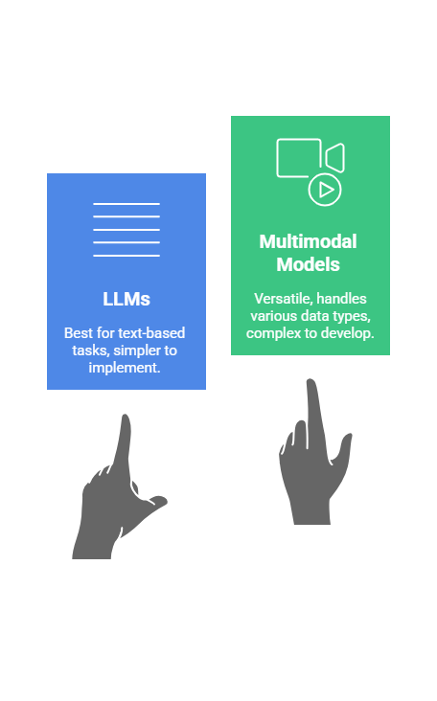
Core Models Overview
Large Language Models (LLMs) work mostly with text.
Multimodal models work with text, images, videos, and sounds.
These models can write, describe images, create videos, and more.
New tech helps models understand different data types together.

Slide 4
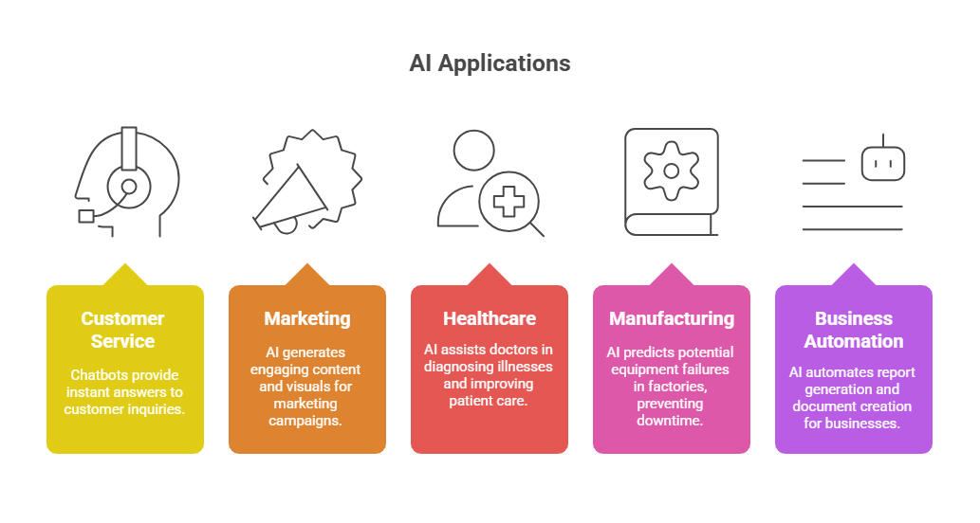
Real-world Use Cases Across Industries
Chatbots to answer customer questions.
AI creates marketing content and images.
Helps doctors with diagnosis and patient care.
Predicts equipment issues in factories.
Automates business reports and document writing.

Slide 5
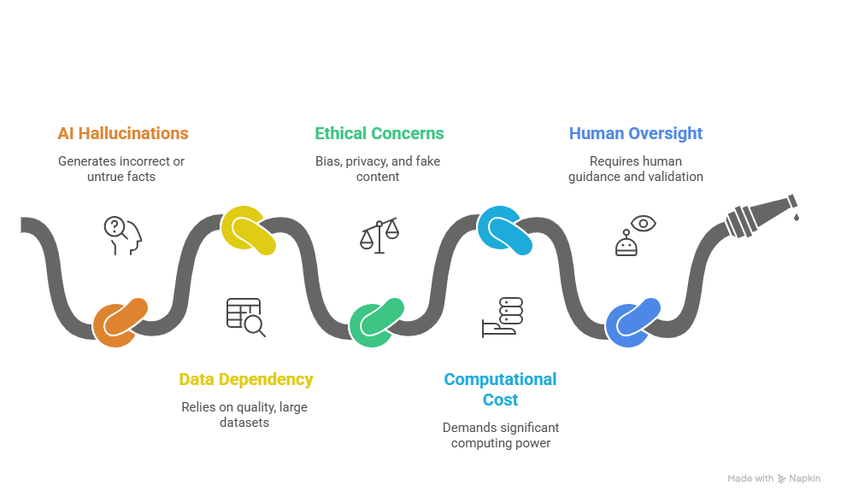
Current Challenges and Limitations
Sometimes AI makes up wrong or untrue facts (hallucinations).
AI depends on large, good quality data.
Risk of bias, privacy issues, and fake content.
Requires lots of computing power.
Humans must check and guide AI use.

Slide 6
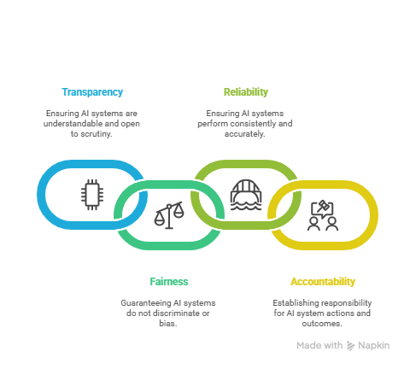
AI Safety Principles and Frameworks
Focus on safety to prevent harm from AI systems.
Key principles: transparency, fairness, reliability, and accountability.
Frameworks guide responsible AI development and use.
Examples: OECD AI Principles, EU AI Act guidelines.

Slide 7
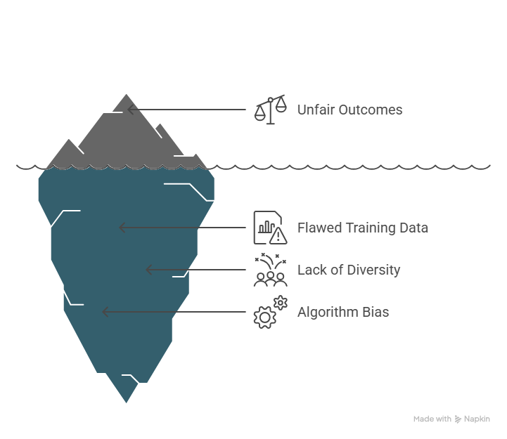
Bias Identification and Mitigation Strategies
Bias arises from unrepresentative or flawed training data.
Can cause unfair outcomes for individuals or groups.
Detection methods: audits, fairness metrics, and testing.
Mitigation: diverse data, algorithm adjustments, human review.

Slide 8
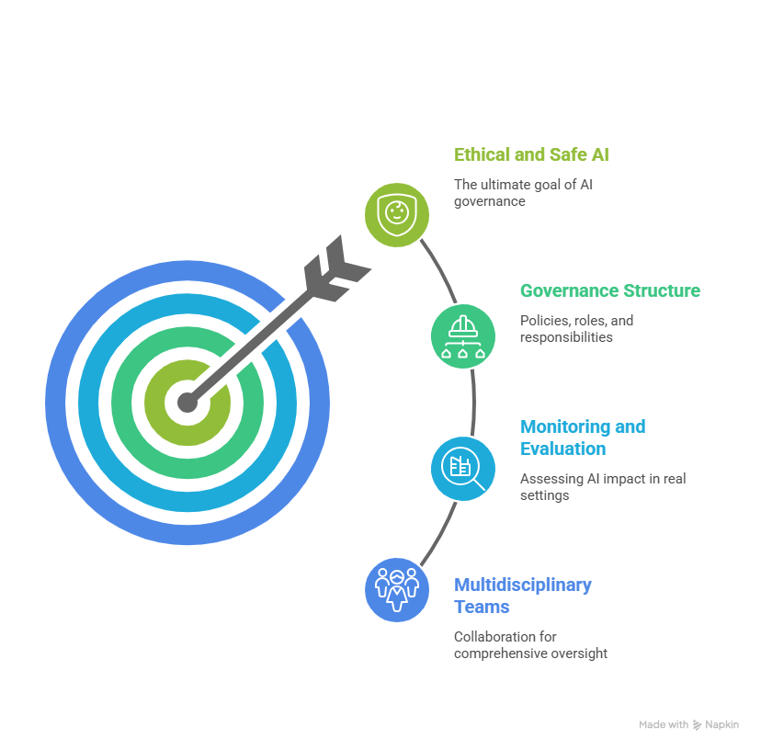
Deployment Standards and Governance
Clear rules for AI deployment to ensure safety and ethics.
Governance includes policies, roles, and responsibilities.
Continuous monitoring of AI impact in real settings.
Involvement of multidisciplinary teams.

